Slide 1
Sound-Based Fault Detection For Machine
Presented By:
Subhamkumar Sharma (20204210)
Raman Jeengar (20204163)
Sarthak Penta (20204178)
Sohan Gond (20204206)
Mentored By: Prof. Anil Kumar Singh

Slide 2
Contents
Introduction
Fault Detection Through Sound Analysis
Dataset Overview
Sound Charcterstics Of Machines
Preprocessing
Spectogram generation
Autoencoder Model Architecture
Result Analysis
Conclusion & Future Work
References

Slide 3
Introduction
Current Approach:
Manual inspections and periodic maintenance routines are relied upon for identifying machine faults
Limitations of current approach:
Current methods have limitations in detecting subtle or early signs of faults, potentially leading to major breakdowns.
Waiting until a problem is evident, can result in increased downtime and higher repair costs.

Slide 4
Fault Detection Through Sound Analysis
Sound as a Diagnostic Tool:
Recognizing the unique sounds machines produce serves as a diagnostic tool for assessing machine health.
Using machine learning to detect fault:
Machine learning excels in recognizing complex patterns and abnormalities in sound
Problem Statement: To develop a unified system that harnesses the power of sound-based analysis, incorporating machine learning to predict faults in a wide array of machinery in different environment

Slide 5
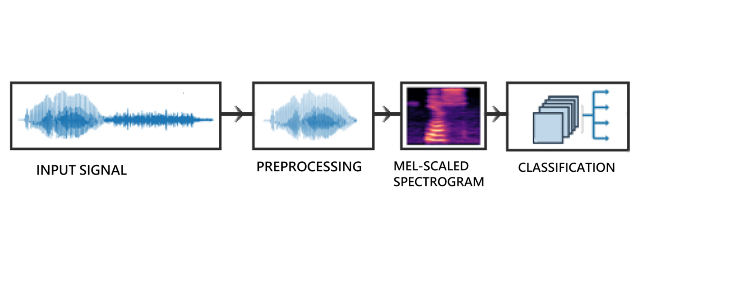
Project Workflow Overview

Slide 6
Dataset Overview
Machines Used:
Three different types: Valves, Pumps, and Fans.
Test Dataset:
Test dataset includes all identified abnormal segments.
Equal number of normal segments chosen randomly for another part of the test dataset.
Training Dataset:
Remaining normal segments designated as the training dataset.

Slide 7
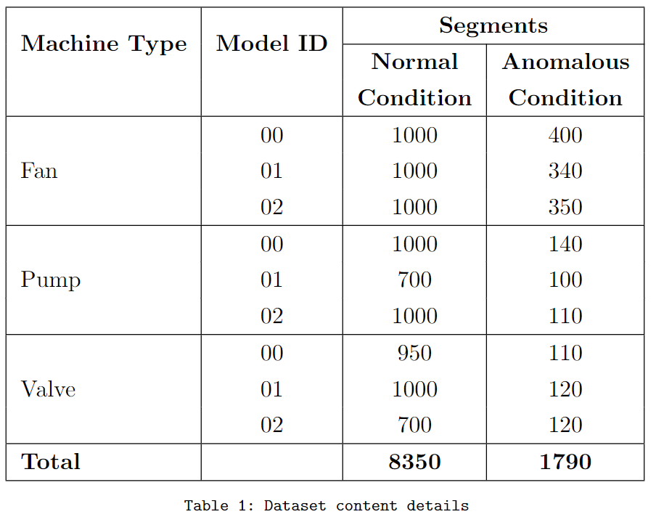
Dataset Overview

Slide 8
Sound Charcterstics Of Machines
Pumps and Fans:
Exhibit relatively constant and steady-state sounds over time.
Characteristic of stationary sounds with continuous, repetitive noises.
Valves:
Produce non-stationary sounds.

Slide 9
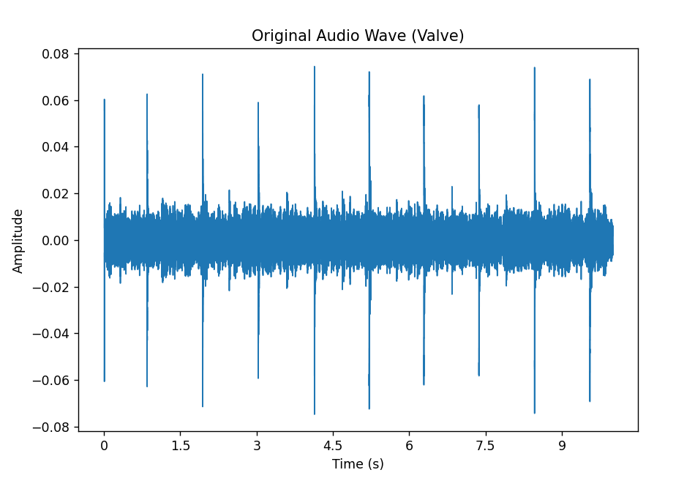
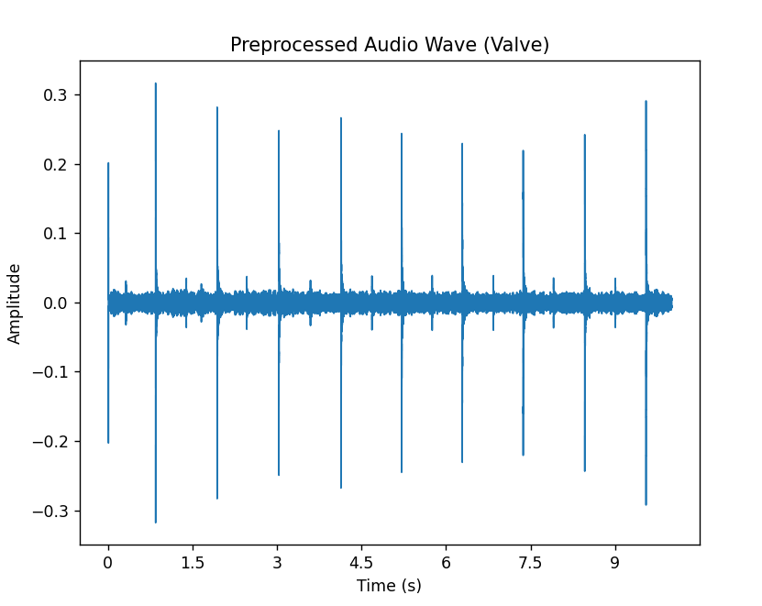
Preprocessing
Preprocessing steps involve converting audio signal into suitable format for further analysis.
The pre-recorded machine sounds in wav file are used
The first step in preprocessing audio is to convert it to a mono signal.
We do not employ information that can be received from other channels, and the mono conversion makes the feature extraction procedure easier

Slide 10
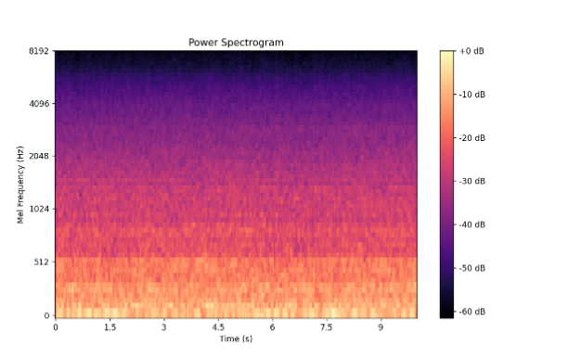
Spectogram generation
Spectrogram Transformation:
Convert preprocessed audio data into a spectrogram, representing frequencies over time.
Mel-Spectrogram Conversion:
Shift the frequency scale to mel-scale to align with human auditory perception.
We have used librosa library to transform the regular spectrogram into a mel-spectrogram.
Fan Power Spectrum

Slide 11
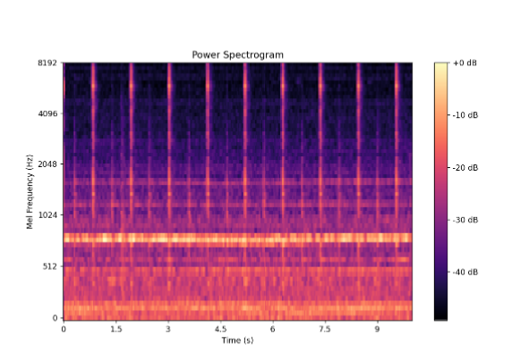
Spectogram generation
Logarithmic Transformation:
Subject the resulting mel-spectrogram to a logarithmic transformation to enhance its representation of human auditory perception.
Feature Vector Creation:
Create feature vectors by grouping frames of the log mel spectrogram.
Resulting in a well-organized dataset for insightful audio analysis in the project.
.
Valve Power Spectrum

Slide 12
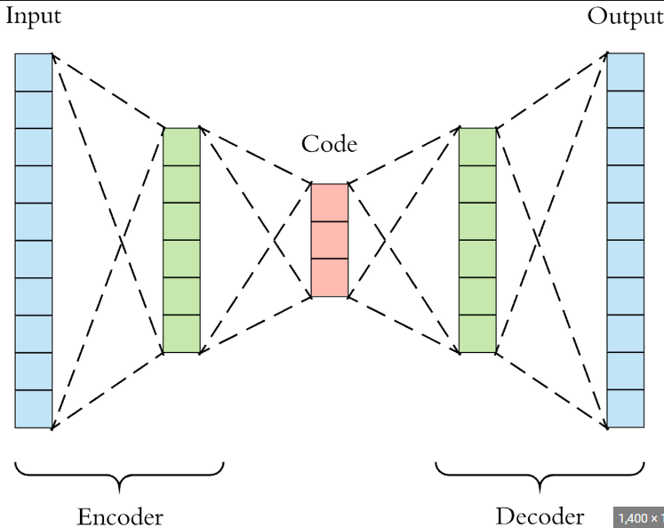
Autoencoder Model Architecture
We have used Keras Library to implement autoencoder.
The architecture comprises an encoder and a decoder.
Encoder Section: Consist of 3 dense layer.
Input Layer -> takes raw input data
First Layer -> 64 neurons, ReLU activation function
Second Layer -> 64 neurons, ReLU activation function
Third Layer -> 8 neurons, ReLU activation function
Decoder Section: It mirror the encoder with three dense Layer
Notes:
ReLU -> Rectified Linear Unit

Slide 13
Autoencoder
Aims to learn a condensed representation in an 8-dimensional space.
The model identifies faults by measuring the reconstruction error and classifying inputs as anomalous when the error exceeds a predefined threshold.

Slide 14
Result Analysis
AUC values were calculated for test datasets of each machine type and model ID.
Valves consistently showed lower AUC values, attributed to their nonstationary, impulsive, and sparse sound signals.
Fans exhibited comparatively higher AUC values due to the stationary nature of their sound signals.

Slide 15
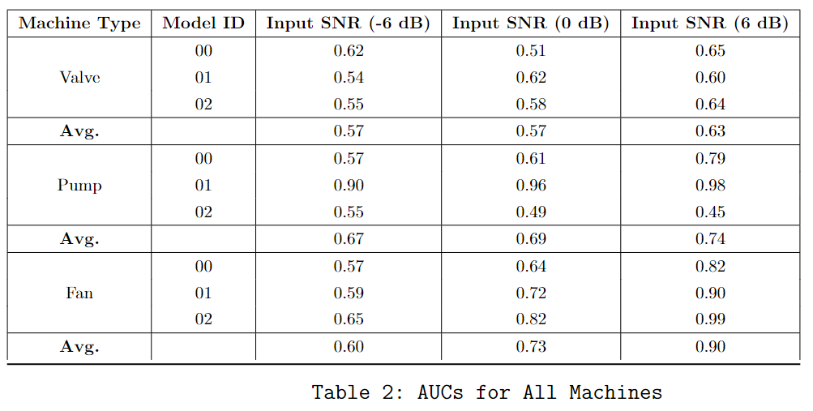
Result Analysis

Slide 16
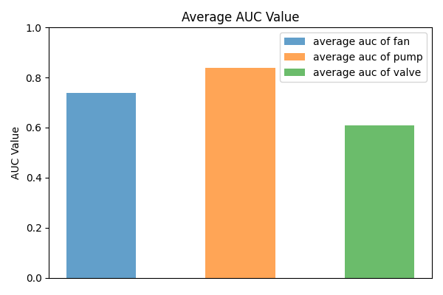
Result Analysis

Slide 17
Result Analysis
Impact of Signal-to-Noise Ratio (SNR) and Observations:
Different SNR levels (6 dB, 0 dB, -6 dB) were considered in the analysis.
AUC values for valves remained consistently low across SNR levels, indicating the challenge of detecting anomalies in nonstationary signals.
Certain machine models experienced a rapid decrease in AUC values with increasing noise levels, emphasizing the impact of non-stationarity and noise on unsupervised anomalous sound detection performance.

Slide 18
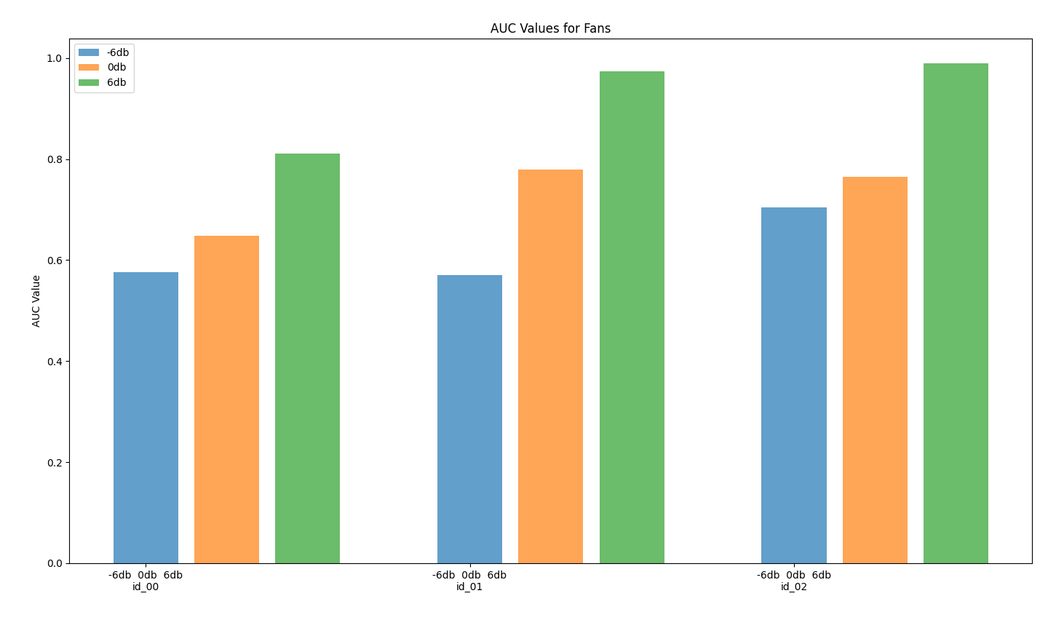
Result Analysis

Slide 19
Conclusion
We successfully identified faults in the machinery through the analysis of audio data
Evaluation of the autoencoder-based unsupervised anomalous sound detection system highlighted two primary challenges: non-stationary machine sound signals and noise.
Non-stationary signals, particularly from machines like valves, posed a challenge to accurate anomaly detection, while noise introduced variability in the results.

Slide 20
Future Work
Future plans involve enhancing fault detection in machines by combining audio data with other types of information, such as vibrations.
Efforts will be directed towards not only detecting faults but also precisely locating and characterizing the nature of the issues
Exploration of deploying fault detection models on edge devices near the machines is considered to process information locally, potentially reducing the need to transmit large amounts of audio data to a central system.

Slide 21
References
Study of machine fault diagnosis system using neural networks [1]
A Hydraulic Pump Fault Diagnosis Method Based on the Modified Ensemble Empirical Mode Decomposition and Wavelet Kernel Extreme Learning Machine Methods[2]
Deep Transfer Learning for Machine Diagnosis: From Sound and Music Recognition to Bearing Fault Detection [3]

